Slide 1

The Bomb Lab

Slide 2

Agenda
Bomb Lab Overview
Assembly Refresher
Introduction to GDB
Unix Refresher
Bomb Lab Demo

Slide 3

The Elephant in the Room

Slide 4
Downloading Your Bomb
Please read the writeup. Please read the writeup. Please Read The Writeup.
Your bomb is unique to you. Dr. Evil has created one million billion bombs, and can distribute as many new ones as he pleases.
Bombs have six phases which get progressively harder more fun to use.
Bombs can only run on your AWS servers

Slide 5
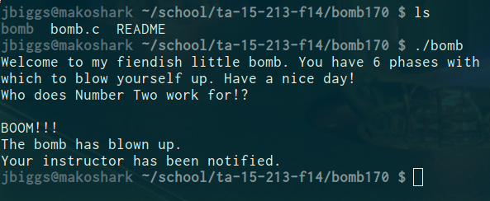
Exploding Your Bomb
Blowing up your bomb notifies the autograder.
Dr. Evil takes 0.25 of your points each time (every 4 explosions -1 pt)
Inputting the right string moves you to the next phase.
Jumping between phases detonates the bomb

Slide 6

Examining Your Bomb
You get:
An executable
A readme
A heavily redacted source file
Source file just makes fun of you
Outsmart Dr. Evil by examining the executable

Slide 7

x64 Assembly: Registers
%rax
%eax
%r8
Return
%r8d
Arg 5
%rbx
Arg 6
%ebx
%r9
%r9d
%rcx
%ecx
%r10
Arg 4
%r10d
Arg 3
%rdx
%edx
%r11
%r11d
Arg 2
%rsi
%esi
%r12
%r12d
Arg 1
%rdi
%edi
%r13
%r13d
Stack ptr
%rsp
%esp
%r14
%r14d
%rbp
%ebp
%r15
%r15d

Slide 8
x64 Assembly: Operands
Type | Syntax | Example | Notes
Constants | Start with $ | $-42 $0x15213b | Don’t mix up decimal and hex
Registers | Start with % | %esi %rax | Can store values or addresses
Memory Locations | Parentheses around a register or an addressing mode | (%rbx) 0x1c(%rax) 0x4(%rcx, %rdi, 0x1) | Parentheses dereference. Look up addressing modes!

Slide 9
x64 Assembly: Arithmetic Operations
Instruction
Effect
mov %rbx, %rdx
add (%rdx), %r8
mul $3, %r8
sub $1, %r8
lea (%rdx,%rbx,2), %rdx
rdx = rbx
r8 += value at rdx
r8 *= 3
r8--
rdx = rdx + rbx*2
lea doesn’t dereference

Slide 10
Procedure Control Flow
Use stack to support procedure call and return
Procedure call: call label
Push return address on stack
Address of the next instruction right after call
Jump to label (update PC)
Procedure return: ret
Pop address of next instruction from stack
Jump to address (update PC)
0000000000400540 <multstore>:
400540: push %rbx # Save %rbx
400541: mov %rdx,%rbx # Save dest
400544: callq 400550 <mult2> # mult2(x,y)
400549: mov %rax,(%rbx) # Save at dest
40054c: pop %rbx # Restore %rbx
40054d: retq # Return
0000000000400550 <mult2>:
400550: mov %rdi,%rax # a
400553: imul %rsi,%rax # a * b
400557: retq # Return

Slide 11
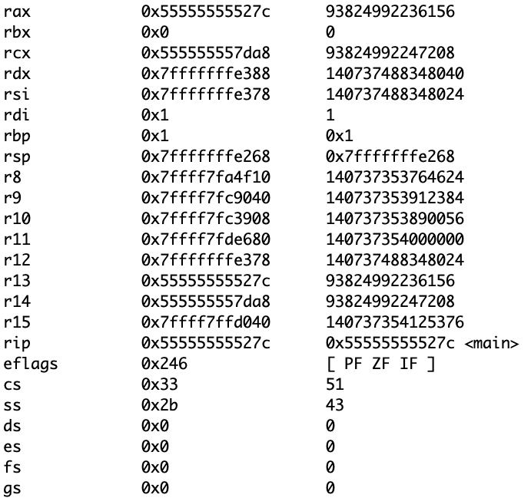
Program counter (PC)
- stands for "instruction pointer"

Slide 12
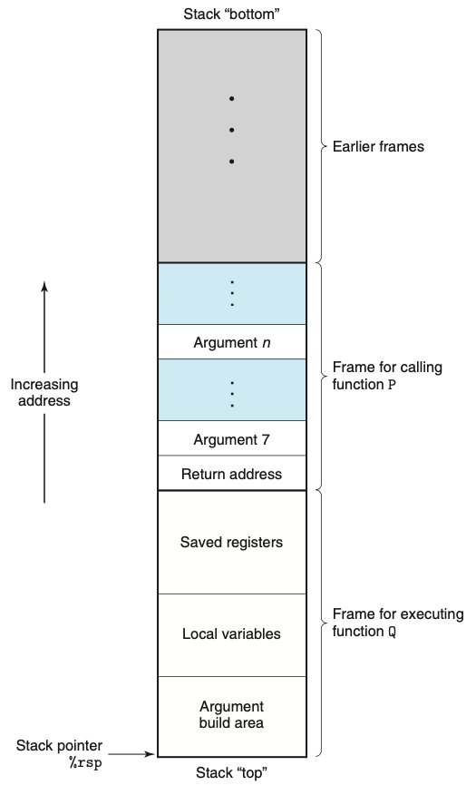
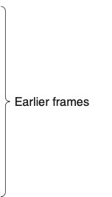


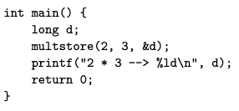
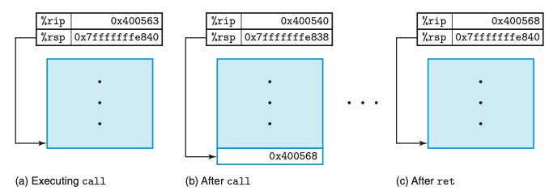
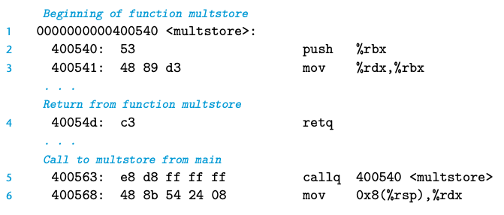

Return addresses

Slide 13
Return addresses
0x40054d

Slide 14
Return addresses

Slide 15
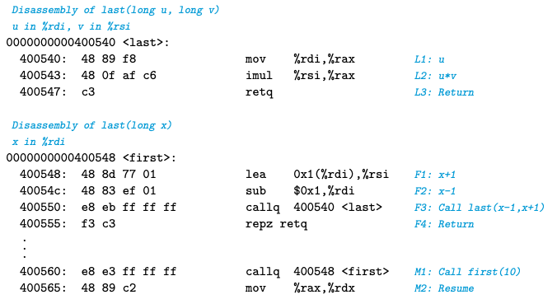
TAPPS (3.32)
Registers
%rip | 0x400560
%rdi | 10
%rsi
%rax
%rsp | 0x7fffffffe820
*%rsp
?
?
?
?
?
?
?
?
?
?
?

Slide 16
TAPPS (3.32)
Registers
%rip | 0x400548
%rdi | 10
%rsi
%rax
%rsp | 0x7fffffffe818
*%rsp | 0x400565
?
?
?
?
?
?
?
?
0x400565
?
?

Slide 17
TAPPS (3.32)
Registers
%rip | 0x40054C
%rdi | 10
%rsi | 11
%rax
%rsp | 0x7fffffffe818
*%rsp | 0x400565
?
?
?
?
?
?
0x400565
?
?

Slide 18
TAPPS (3.32)
Registers
%rip | 0x400550
%rdi | 9
%rsi | 11
%rax
%rsp | 0x7fffffffe818
*%rsp | 0x400565
?
?
?
?
?
0x400565
?
?

Slide 19
TAPPS (3.32)
Registers
%rip | 0x400540
%rdi | 9
%rsi | 11
%rax
%rsp | 0x7fffffffe810
*%rsp | 0x400555
?
?
?
?
0x400565
?
0x400555
?

Slide 20
TAPPS (3.32)
Registers
%rip | 0x400543
%rdi | 9
%rsi | 11
%rax | 9
%rsp | 0x7fffffffe810
*%rsp | 0x400555
?
?
0x400565
?
0x400555
?

Slide 21
TAPPS (3.32)
Registers
%rip | 0x400547
%rdi | 9
%rsi | 11
%rax | 99
%rsp | 0x7fffffffe810
*%rsp | 0x400555
?
0x400565
?
0x400555
?

Slide 22
TAPPS (3.32)
Registers
%rip | 0x400555
%rdi | 9
%rsi | 11
%rax | 99
%rsp | 0x7fffffffe818
*%rsp | 0x400565
0x400565
?
?

Slide 23
TAPPS (3.32)
Registers
%rip | 0x400565
%rdi | 9
%rsi | 11
%rax | 99
%rsp | 0x7fffffffe820
*%rsp
?

Slide 24
x64 Assembly: Comparisons
Comparison, cmp, compares two values
Result determines next conditional jump instruction
cmp b,a computes a-b; test b,a computes a&b
Pay attention to operand order
cmpl %r9, %r10
jg 8675309
If %r10 > %r9, then jump to 8675309

Slide 25
x64 Assembly: Jumps
Instruction | Effect | Instruction | Effect
jmp | Always jump | ja | Jump if above (unsigned >)
je/jz | Jump if eq / zero | jae | Jump if above / equal
jne/jnz | Jump if !eq / !zero | jb | Jump if below (unsigned <)
jg | Jump if greater | jbe | Jump if below / equal
jge | Jump if greater / eq | js | Jump if sign bit is 1 (neg)
jl | Jump if less | jns | Jump if sign bit is 0 (pos)
jle | Jump if less / eq

Slide 26
x64 Assembly: A Quick Drill
cmp $0x15213, %r12
jge deadbeef
cmp %rax, %rdi
jae 15213b
test %r8, %r8
jnz (%rsi)
If , jump to addr 0xdeadbeef
If , jump to addr 0x15213b
If , jump to .

Slide 27
x64 Assembly: A Quick Drill
cmp $0x15213, %r12
jge deadbeef
cmp %rax, %rdi
jae 15213b
test %r8, %r8
jnz (%rsi)
If %r12 >= 0x15213, jump to 0xdeadbeef

Slide 28
x64 Assembly: A Quick Drill
If the unsigned value of %rdi is at or above the unsigned value of %rax, jump to 0x15213b.
cmp $0x15213, %r12
jge deadbeef
cmp %rax, %rdi
jae 15213b
test %r8, %r8
jnz (%rsi)

Slide 29
x64 Assembly: A Quick Drill
If %r8 & %r8 is not zero, jump to the address stored in %rsi.
cmp $0x15213, %r12
jge deadbeef
cmp %rax, %rdi
jae 15213b
test %r8, %r8
jnz (%rsi)

Slide 30
Diffusing Your Bomb
objdump -t bomb examines the symbol table
objdump -d bomb disassembles all bomb code
strings bomb prints all printable strings
gdb bomb will open up the GNU Debugger
Things to examine while stepping through your program
registers
the stack
contents of program memory
instruction stream

Slide 31
Using gdb
break <location>
Stop execution at function name or address
Reset breakpoints when restarting gdb
run <args>
Run program with args <args>
Convenient for specifying text file with answers
disas <fun>, but not dis
stepi / nexti
Steps / does not step through function calls

Slide 32
Using gdb
info registers
Print hex values in every register
print (/x or /d) $eax - Yes, use $
Print hex or decimal contents of %eax
x $register, x 0xaddress
Prints what’s in the register / at the given address
By default, prints one word (4 bytes)
Specify format: /s, /[num][size][format]
x/8a 0x15213
x/4wd 0xdeadbeef

Slide 33
sscanf
Bomb uses sscanf for reading strings
Figure out what phase expects for input
Check out man sscanf for formatting string details

Slide 34
If you get stuck
Please read the writeup. Please read the writeup. Please Read The Writeup.
CS:APP Chapter 3
View lecture notes and homework assignments from Ch3
TA office hours: https://sites.google.com/isu.edu/cs-tutors/home/cs-tutor-schedule
man gdb, man sscanf, man objdump

Slide 35
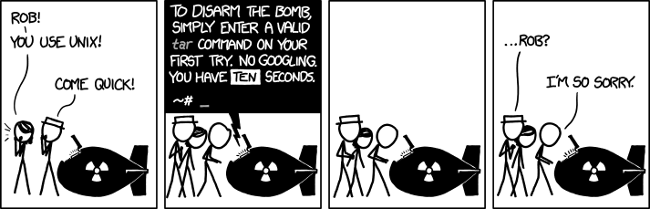
You got this
You should know cd, ls, ssh, and chmod by now. Use man <command> for help.
This lab also requires scp and tar
Use man <command> for help.
<Control-C> exits your current program.

Slide 36
Bomb Lab Demo...

